Slide 1
Introduction to replication in mongo
Notes:
This presentation provides various features, such as authentication, access control, to secure your MongoDB deployments.

Slide 2
Replication
A replica set in MongoDB is a group of mongod processes that maintain the same data set. In simple terms replication is maintaining redundant copies of data on multiple machines. Replica sets provide redundancy and high availability, and are the basis for all production deployments.

Slide 3
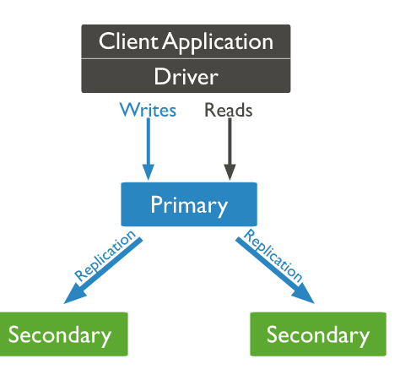

Slide 4
Advantages of Replication
High availability of data in case of a failover.
Durability of data which makes it lot more safer and easy recovery in case of a disaster.
Increased read scalability as the reads can be performed even from the secondary database.
In case of geographic workloads reads can be even more faster if secondary servers are present in different geographic locations. Although replication provides these 4 advantages but the primary reasons why we do replication is due to High availability and Durability of data.

Slide 5
Replica set Oplog
The oplog (operations log) is a special capped collection that keeps a rolling record of all operations that modify the data stored in your databases. MongoDB applies database operations on the primary and then records the operations on the primary’s oplog. The secondary members then copy and apply these operations in an asynchronous process. All replica set members contain a copy of the oplog, in the local.oplog.rs collection, which allows them to maintain the current state of the database.
Notes:
Capped collections are fixed-size collections that support high-throughput operations that insert and retrieve documents based on insertion order. Capped collections work in a way similar to circular buffers: once a collection fills its allocated space, it makes room for new documents by overwriting the oldest documents in the collection.

Slide 6
Some features in Replication
Asynchronous replication: Replication in mongo happens asynchronously i.e. writes are done on primary for which the client gets the acknowledgement way before the writes are actually replicated on secondary servers.
Master/slave replication: Mongo follows master/slave notation wherein only one node will handle all write request and will serve as the master of all available nodes, others will just do what the primary node already did.

Slide 7
Some features in Replication (Contd.)
Statement based replication : In statement based replication the replication is done via the write statements which are send to secondary nodes with the help of oplog collection. for eg:- we do a delete operation in primary i.e. db.emp.remove({age:30}), suppose it deletes 100 documents, so statement based replication will actually replicate by sending 100 statements each containing statement to remove document by _id field. Statement based help overcome issues which might come if 2 servers are running of different mongo version, if diff engine is used one saving uncompressed data and other using compressed data. Such issue might come if binary based replication was used.

Slide 8
Some features in Replication (Cont.)
Automatic failover : Mongo provides the feature of automatic failover wherein whenever primary node goes down one of the available nodes becomes the primary and whenever the failed node recovers it starts working as secondary node. Drivers are replica set aware, so if a failover occurs driver will hit all other members of replica sets till it identifies the primary node and than start talking to the same.
Automatic rollbacks in node recovery: Whenever a node fails it becomes a secondary node on recovery. But what about the data that it wrote but was never able to replicate on secondary servers due to async replication ? In such cases mongo automatically rollbacks such writes and the server which is restored recently starts replicating from primary after the rollback is done.

Slide 9
Setting up replication
Set up a config object containing information of all members of replica set Var cfg = { _id:’anand’ , members : [ {_id:0, host:”localhost:27001”}, {_id:1, host:”localhost:27002”}, {_id:2, host:”localhost:27003”} ]}
Start the replica set by rs.initiate(cfg);

Slide 10
Replica set commands
rs.status() // gets the status of the replica set
rs.initiate(cfg) // initiates a replica set with specified configuration object
rs.conf() // it will show us config related details of replica set
rs.stepDown(sec) // to take down primary for a certain period of time
rs.reconfig(cfg) // to update the config of replica set
rs.add(memberConfigObj) // adds a new host to replica set
rs.remove(hostPortStr) // removes a host from replica set
rs.freeze(secs) // make a node ineligible to become primary for specified duration
rs.slaveOk() // to allow mongo server to run read commands on secondary
rs.isMaster() // to check if current node is a primary node
Notes:
Capped collections are fixed-size collections that support high-throughput operations that insert and retrieve documents based on insertion order. Capped collections work in a way similar to circular buffers: once a collection fills its allocated space, it makes room for new documents by overwriting the oldest documents in the collection.

Slide 11
Read preferences
Following are the available read preferences of which by default is primary :
primary
primaryPreferred
secondary
secondaryPreferred
nearest

Slide 12
References
https://university.mongodb.com/course/MongoDB/M102/2017_August/chapter/Chapter_4_Replication/lesson/5523404dd8ca3941fb77dfe9/tab/vertical_d04aef53b4c3
https://docs.mongodb.com/manual/replication/

Slide 13
Exercise
Start MongoDB without authentication
Create Database ttn and insert some data into user collection.
Setup the replication with Artiber and verify that ttn database is replicated into secondary.
Add 2 more members to replica set with
rs.add();
Try adding a member which already have data.

Slide 14
THANK YOU QUESTIONS ??
Notes:
sudo mongod --port 27001 --replSet abc --dbpath ./first/ --logappend --logpath ./first/log.1 --fork
sudo mongod --port 27002 --replSet abc --dbpath ./second/ --logappend --logpath ./second/log.1 --fork
sudo mongod --port 27003 --replSet abc --dbpath ./third/ --logappend --logpath ./third/log.1 --fork

